Slide 1
6 Optimization
Laura Hervert Escobar

Slide 2

Objectives
6.1 Know the fundamental of optimization algorithms.
6.2 Solve problems using: linear and nonlinear optimization and genetic algorithms.

Slide 3

Introduction
Assume the function f(x) is continuous on the closed interval [a,b], so the integral I(f) exists. In this chapter we develop efficient methods for computing approximations to the integral using only the values of the integrand f(x) at points $x∈[a,b]$.
The need of finding the numerical integration of functions arise because not all functions can be analytically integrated or the analytic integral my not be the most convenient way of finding the solution to a problem.

Slide 4
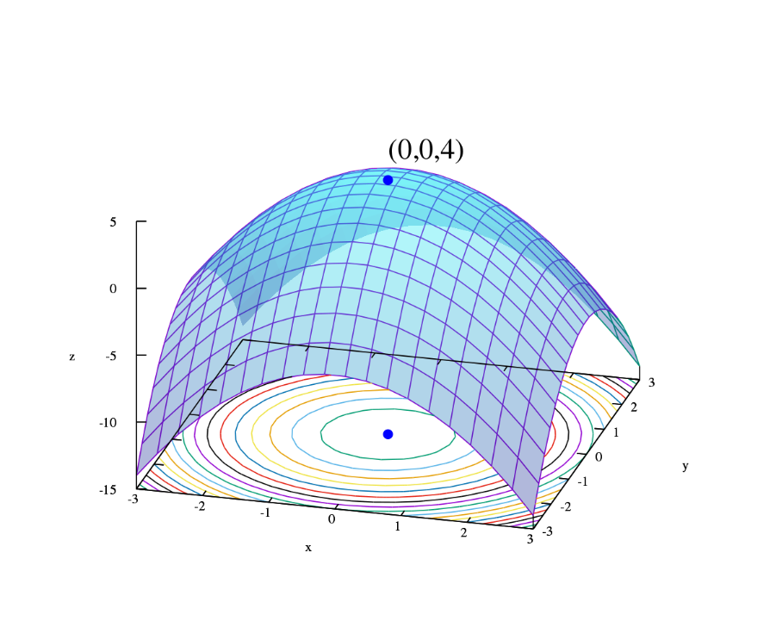
Optimization
Optimization is the act of achieving the best possible result under given circumstances.
In design, construction, maintenance, ..., engineers have to take decisions. The goal of all such decisions is either to minimize effort or to maximize benefit.
The effort or the benefit can be usually expressed as a function of certain design variables.
Hence, optimization is the process of finding the conditions that give the maximum or the minimum value of a function

Slide 5
Optimization
If a point x* corresponds to the minimum value of a function f(x), the same point corresponds to the maximum value of the function −f(x). Thus, optimization can be taken to be minimization.
There is no single method available for solving all optimization problems efficiently. Hence, a number of methods have been developed for solving different types of problems.
Optimum seeking methods are also known as mathematical programming techniques, which are a branch of operations research.

Slide 6
Operation Research area
Mathematical programming methods. These are useful in finding the minimum of a function of several variables under a prescribed set of constraints.
Stochastic process techniques. These are used to analyze problems which are described by a set of random variables of known distribution.
Statistical methods. These are used in the analysis of experimental data and in the construction of empirical models

Slide 7
Mathematical programming
calculus of variations and optimal control
linear, quadratic and non-linear programming
geometric programming
integer programming
network methods (PERT)
game theory.

Slide 8
History of optimization
The existence of optimization can be traced back to Newton, Lagrange and Cauchy.
The development of differential methods for optimization was possible because of the contribution of Newton and Leibnitz.
The foundations of the calculus of variations were laid by Bernoulli, Euler, Lagrange and Weierstrasse.
Constrained optimization was first studied by Lagrange and the notion of descent was introduced by Cauchy.

Slide 9

Implementation
Despite these early contributions, very little progress was made till the 20th century, when computer power made the implementation of optimization procedures possible and this in turn stimulated further research methods.
The major developments in the area of numerical methods for unconstrained optimization have been made in the UK.
These include the development of the simplex method (Dantzig,1947), the principle of optimality (Bellman, 1957), necessary and sufficient conditions of optimality (Kuhn and Tucker, 1951).

Slide 10

Applications
Warehouse placement
Warehouse
location
Minimize Shipment Time

Slide 11
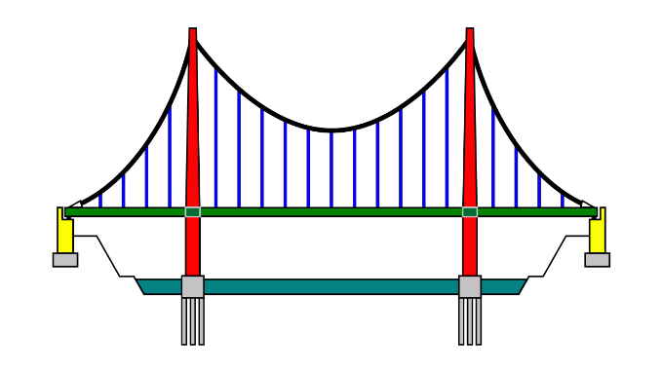
Applications
Bridge construction
Maximize
Load
Bearing
Design

Slide 12
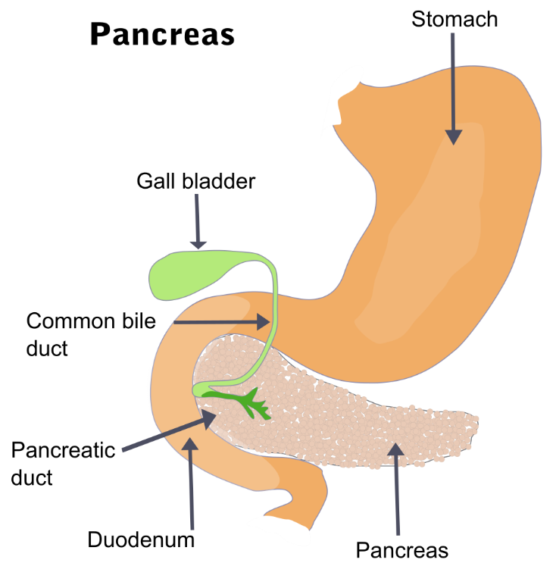
Applications
Artificial Pancreas
Minimize Blood Sugar Deviations
Insulin delivery

Slide 13


Applications
Stock Market
Stock
Portfolio
Maximize
returns

Slide 14
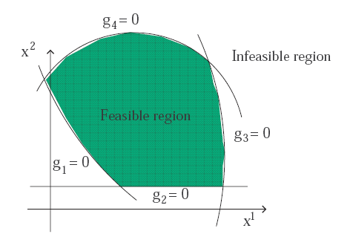
Statement of optimization problems
Find
x=(x₁,x₂,x₃,…,x_{n})
Which minimizes
f(x)
Subject to constraints
gj(x) ≥ 0
For j=1,…m and
l_{j}(x)=0
For j=1,…p
The variable x is called the design vector, f(x) is the objective function, gj(x) are the inequality constraints and lj(x) are the equality constraints. The number of variables n and the number of constraints p+m need not be related. If p+m=0 the problem is called an unconstrained optimization problem

Slide 15
Classification of optimization problems
Existence of constraints.
An optimization problem can be classified as a constrained or an unconstrained one, depending upon the presence or not of constraints.
Nature of the equations.
Optimization problems can be classified as linear, quadratic, polynomial, non-linear depending upon the nature of the objective functions and the constraints. This classification is important, because computational methods are usually selected on the basis of such a classification, i.e. the nature of the involved functions dictates the type of solution procedure.
Admissible values of the design variables.
Depending upon the values permitted for the design variables, optimization problems can be classified as integer or real valued, and deterministic or stochastic.

Slide 16

Example
A travelling salesman has to cover n towns. He plans to start from a particular town numbered 1, visit each one of the other n − 1 towns, and return to the town 1. The distance between town i and j is given by d_{ij} .
How should he select the sequence in which the towns are visited to minimize the total distance travelled?

Slide 17
Example
A manufacturing firm produces two products, A and B, using two limited resources, 1 and 2. The maximum amount of resource 1 available per week is 1000 and the maximum amount of resource 2 is 250. The production of one unit of A requires 1 unit of resource 1 and 1/5 unit of resource 2. The production of one unit of B requires 1/2 unit of resource 1 and 1/2 unit of resource 2. The unit cost of resource 1 is 1−0.0005u1, where u1 is the number of units of resource 1 used. The unit cost of resource 2 is 3/4−0.0001u2, where u2 is the number of units of resource 2 used. The selling price of one unit of A is
2 − 0.005xA − 0.0001xB
and the selling price of one unit of B is
4 − 0.002xA − 0.01xB,
where xA and xB are the number of units of A and B sold. Assuming that the firm is able to sell all manufactured units, maximize the weekly profit.

Slide 18
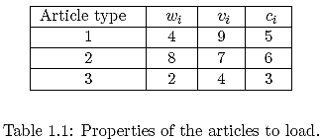
Example
A cargo load is to be prepared for three types of articles. The weight, wi, volume, vi, and value, ci, of each article is given in Table 1.1.
Find the number of articles xi selected from type i so that the total value of the cargo is maximized. The total weight and volume of the cargo cannot exceed 2000 and 2500 units respectively.

Slide 19
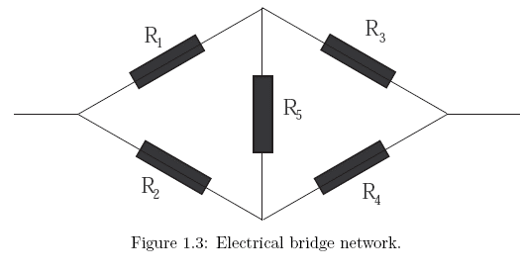
Example
The bridge network in Figure consists of five resistors R_{i}, i = 1, . . . , 5.
Let I_{i} be the current through the resistance R_{i}, find the values of R_{i} so that the total dissipated power is minimum. The current I_{i} can vary between the lower limit I_{i} and the upper limit Ī_{i} and the voltage drop V_{i} = R_{i}I_{i} must be equal to a constant c_{i}.

